Slide 1
Principles of Database Systems (CS307) Lecture 13: View; Access Control
Ran Cheng
Department of Computer Science and Engineering
Southern University of Science and Technology
Most contents are from slides made by Stéphane Faroult, Dr Yuxin Ma and the authors of Database System Concepts (7th Edition).
Their original slides have been modified to adapt to the schedule of CS307 at SUSTech.
Notes:
In this chapter, I will introduce how to retrieve data from one table. Just from one table. I will introduce how to retrieve data from multiple table in next chapter.

Slide 2
View

Slide 3
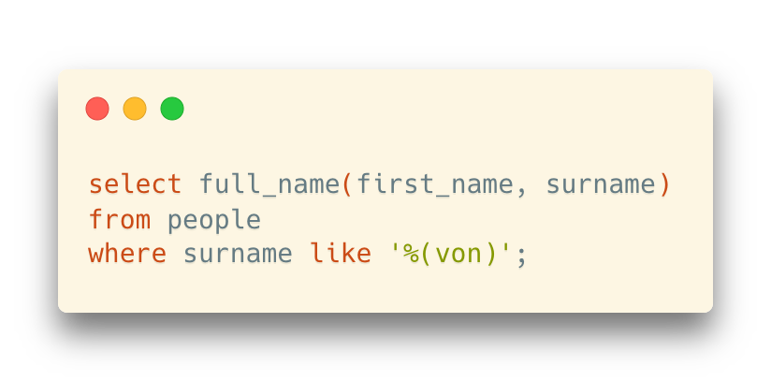
Recall: Function
Used for returning numbers, strings, dates, etc.
Or, return a single value
Trigger?
… returns a string of the full name

Slide 4
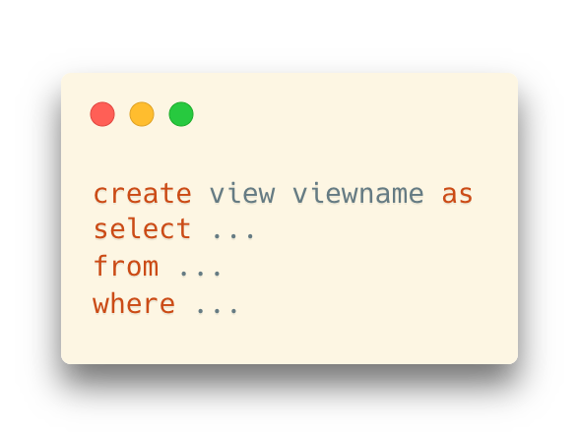
View
Reuse of the relational operations (as we reuse codes in a program)
... which returns relations (tables) instead of simple values

Slide 5
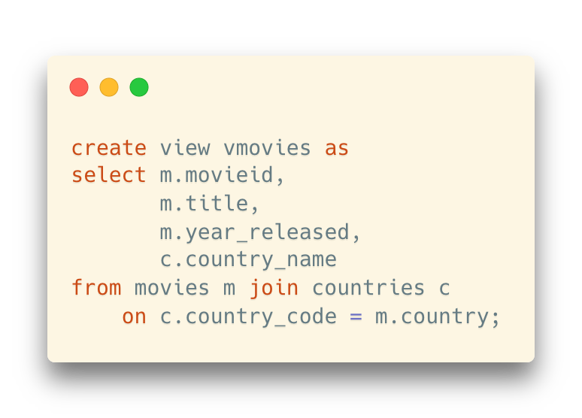
View
Example: Create a view like this:

Slide 6
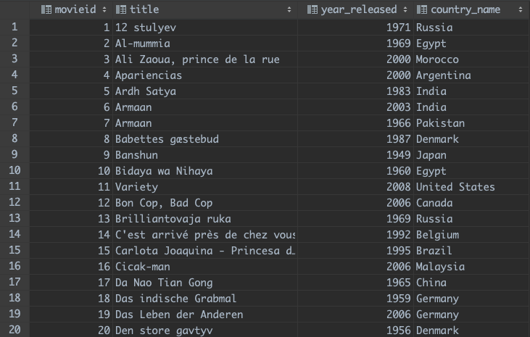
View
Example: Create a view like this:
… where the result of the inner select query looks like this:

Slide 7
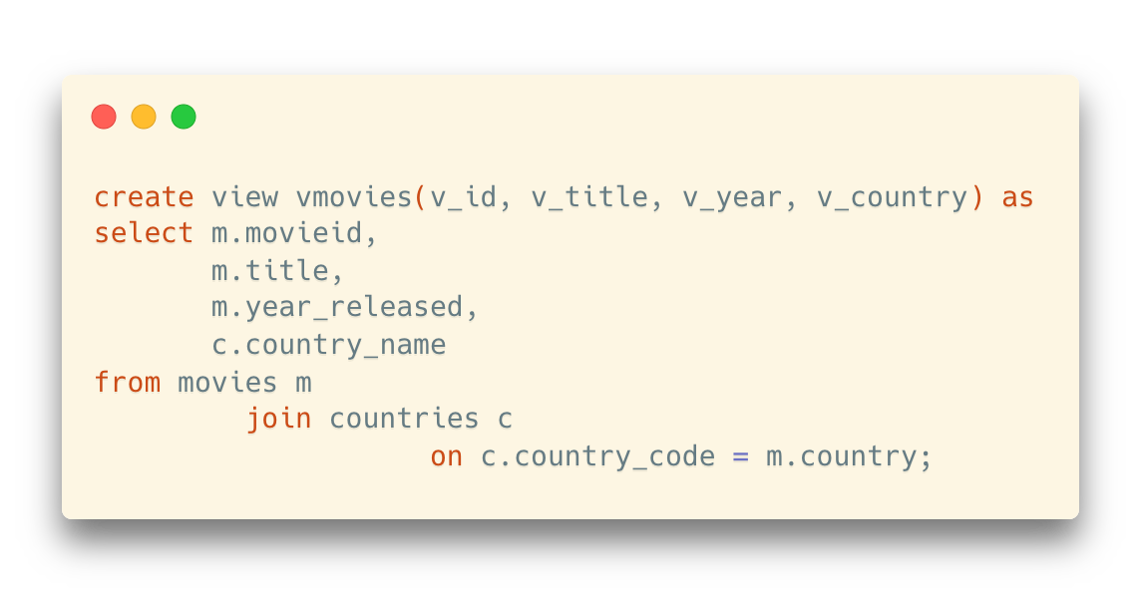
View vs. Table
In practice, there isn't much to a view
It’s basically a named query
And, why not just consider it as a “virtual table”?

Slide 8
View vs. Table
In practice, there isn't much to a view
It’s basically a named query
And, why not just consider it as a “virtual table”?
The columns can be renamed
Otherwise, the original names in the tables will be used

Slide 9
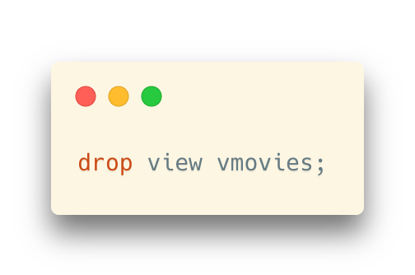
View vs. Table
In practice, there isn't much to a view
It’s basically a named query
And, why not just consider it as a “virtual table”?
The columns can be renamed
Otherwise, the original names in the tables will be used
Drop the existing view before creating a new one with the same name:

Slide 10
View vs. Table
A view can be as a complicated query as you want
It will usually return something that isn't as normalized as your tables, but easier to understand.
Imagine: a function of a select query
From a programming language’s view:
Tables -> variables
Rows -> values

Slide 11
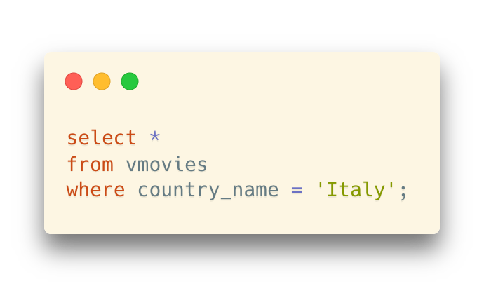
View vs. Table
Once the view is created,
… we can query the view exactly as if it were a table

Slide 12
View vs. Table
Once the view is created,
… we can query the view exactly as if it were a table
Use the view name in the from clause
… as if it were a “table”

Slide 13
Dynamic Content in Views
When the rows change in the tables where a view relies on, the result of a view will change as well
Think it like a table variable, or a query result
* Or, think it like a relational function which returns a relation

Slide 14
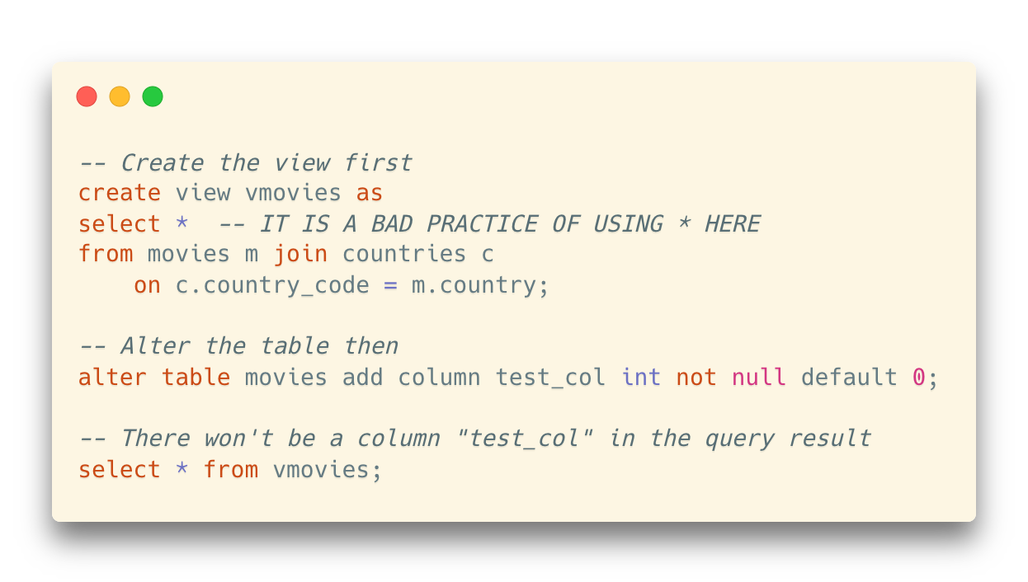
Dynamic Content in Views
Beware that columns are the one in tables when the view was created
Columns added later to tables in the view won’t be added even if the view was created with “select *”
And, “select *” is a bad practice in view. We will not know what exact columns are selected once the columns in the tables are changed.

Slide 15
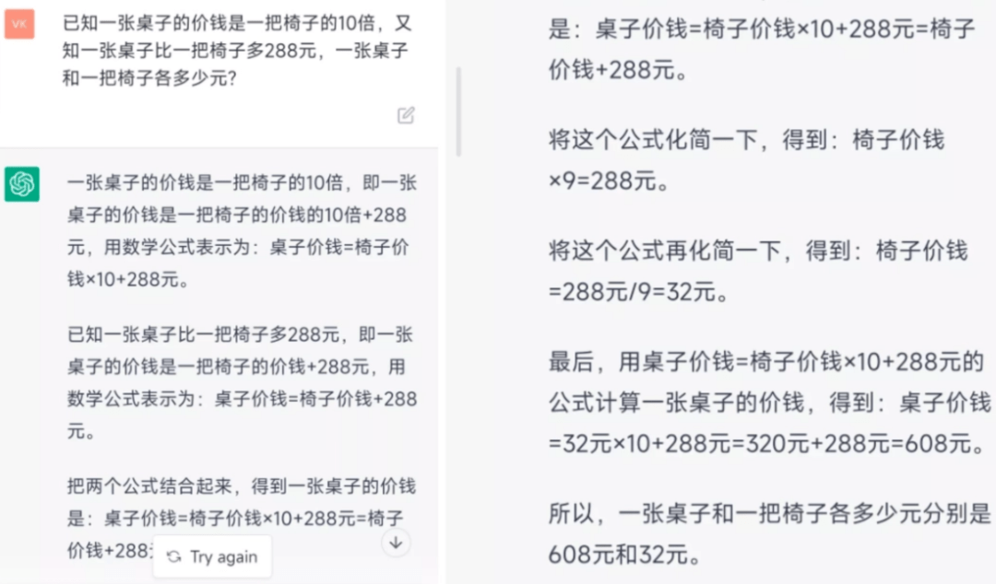
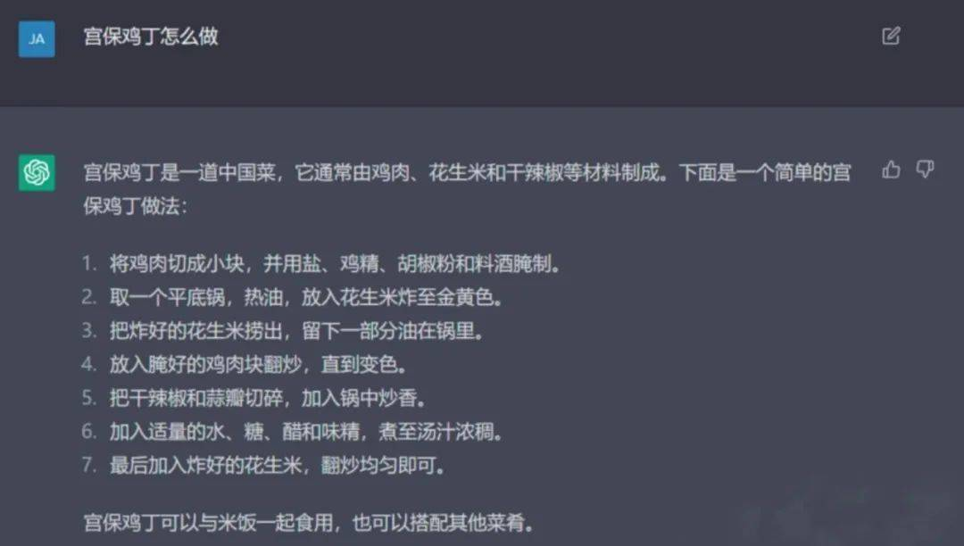
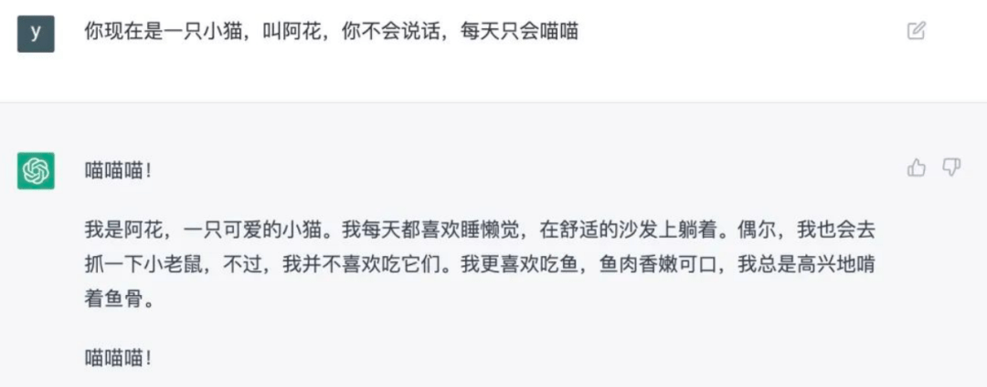

View vs. Table (Cont.)
View looks like Table, tastes like Table – functionalized (函数化) Table
Sometimes it is used as a table, table
AI is functionalized intelligence？

Slide 16
View vs. Table (Cont.)
View looks like Table, tastes like Table
Sometimes it is used as a table
Usage Scenario 1: Simplify Complex Queries
Simplify a complicated query result into a single named query
E.g. Many business reports are based on the same set of joins, with just variations on the columns that you aggregate or order by
One command, same query (Example? )
饭卡余额

Slide 17
View vs. Table (Cont.)
View looks like Table, tastes like Table
Sometimes it is used as a table
Usage Scenario 2: An alternative way to implement E-R models
Sometimes, we may NOT be able to use tables to model entities and relationships
Access control (部分可见)
Dirty and messy original data (预处理)
Since views look like tables, we can use views to represent entities or relationships
… based on some existing objects (like tables)
There are more than one way to implement E-R models

Slide 18
Drawback of Views
View looks like Table, tastes like Table
But it is still not a table.
In some cases, it may cause performance issues or unnecessary operations
* … since the users of the views don’t know the details of the views

Slide 19
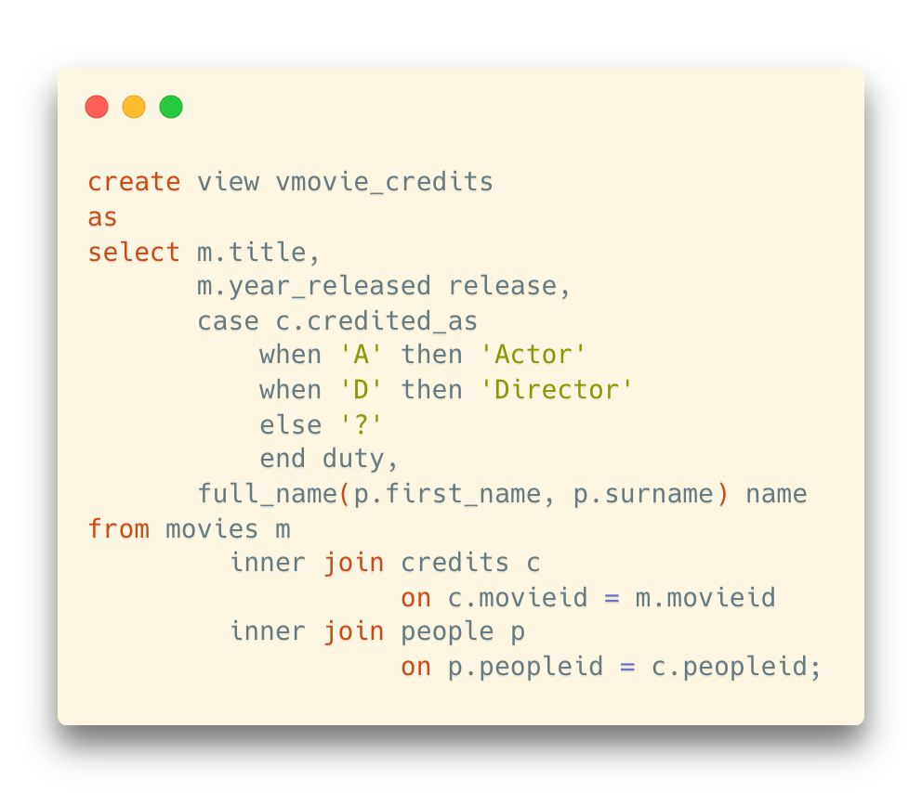
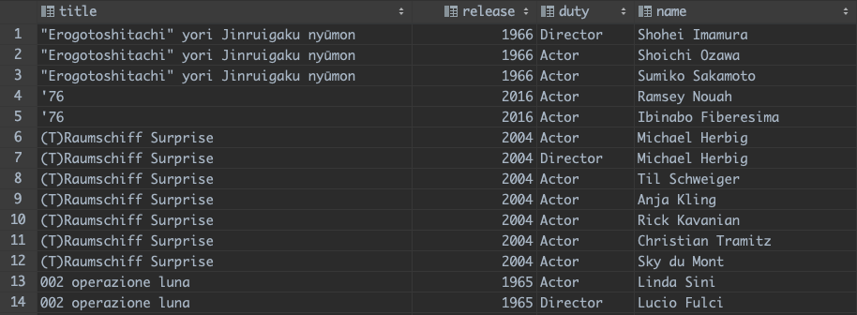
Drawback of Views
View looks like Table, tastes like Table
Example: A refined way to display the credit information with a view

Slide 20
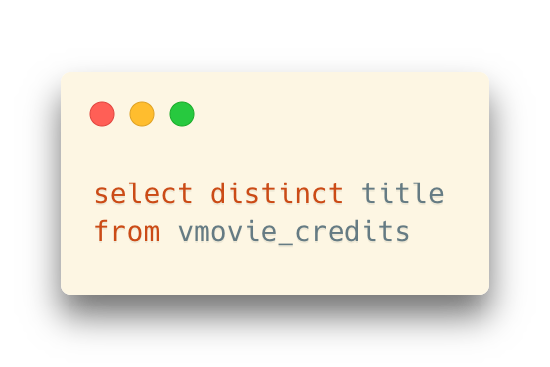
Drawback of Views
View looks like Table, tastes like Table, BUT if you REALLY treat it as a Table
Example: A refined way to display the credit information with a view
However, if we only want to get all distinct movie titles, it will return the correct result, but there are a lot of useless works in the internal query of the view
Do we really need the joins?

Slide 21
Access Control

Slide 22
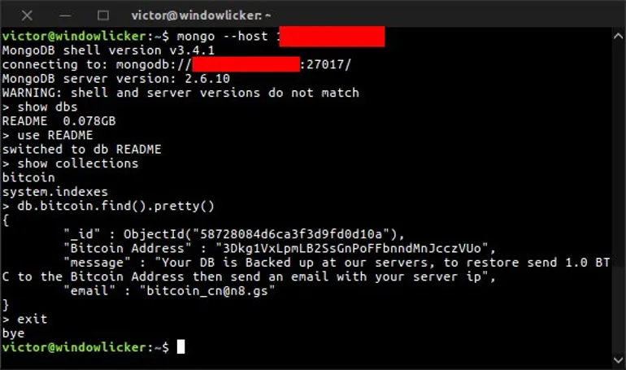
Authentication (身份验证)
To access a database, you must be authenticated, which often means entering a username and a password.
If you don’t set a proper password, you will put your database system in danger
https://www.zdnet.com/article/mongodb-ransacked-now-27000-databases-hit-in-mass-ransom-attacks/

Slide 23
Privileges
Besides, DBMS usually provide another layer of access control on objects in the system
Operations (select, update, insert, delete, etc.)
Objects (table, database, views, trigger, etc.)

Slide 24
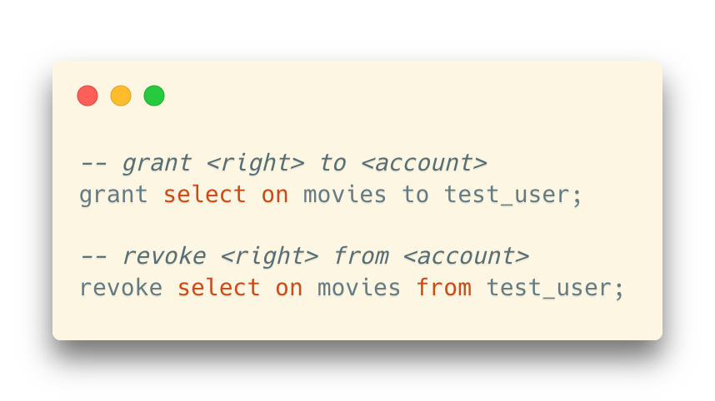
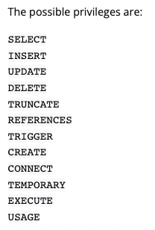
Grant and Revoke Access
grant and revoke
Can be used on the table or the database level
https://www.postgresql.org/docs/current/sql-grant.html

Slide 25
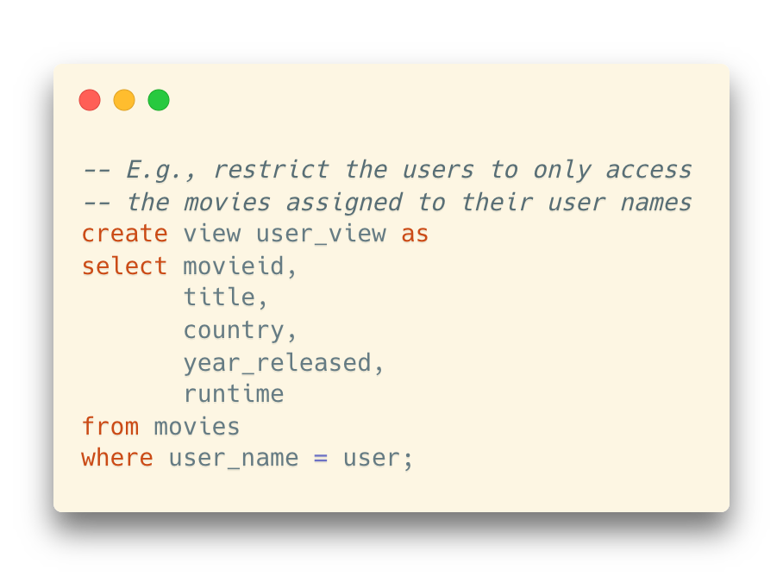
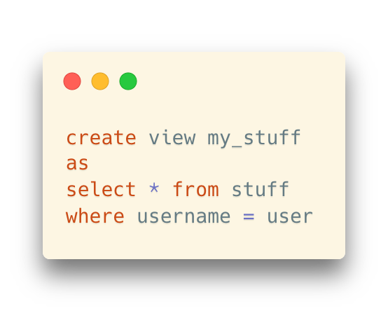
How Can Views Help
User access control
By creating a view that only returns rows associated with the user name, we can control the privileges for a specific user in this table

Slide 26
How Can Views Help
User access control
By creating a view that only returns rows associated with the user name, we can control the privileges for a specific user in this table
user: An internal variable that returns the current user name
Remember new in triggers?
How about NULL and old in triggers?

Slide 27
Something more about Trigger: NULL
Trigger functions are always declared as “RETURNS trigger”, but what you actually have to return is
for statement level triggers, the value always NULL
for row level triggers, a row of the table on which the trigger is defined
The return value is ignored for row level AFTER triggers, so you may as well return NULL in that case.
For row level BEFORE triggers, there are two cases:
if the trigger returns NULL, the triggering operation is aborted, and the row will not be modified
for INSERT and UPDATE triggers, the returned row is the input for the triggering DML statement

Slide 28
Something more about Trigger: NEW and OLD
NEW and OLD in row level triggers in a row level trigger function contain the new row version and the old row version respectively. They can be used in the RETURN statement.
Note that NEW is NULL in ON DELETE triggers and OLD is NULL in ON INSERT triggers.
trigger invocation | NEW is set | OLD is set
ON INSERT | new row version | NULL
ON UPDATE | new row version | old row version
ON DELETE | NULL | old row version

